Slide 1
McStas Introduction
CSNS McStas training
March 25th-29th 2019

Slide 2
Agenda
A (very) brief introduction to neutrons, Monte Carlo & raytracing
Components of neutron instruments
How McStas works under the hood
Components and instruments
A demo

Slide 3
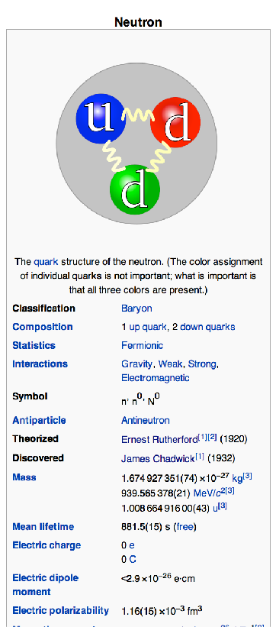
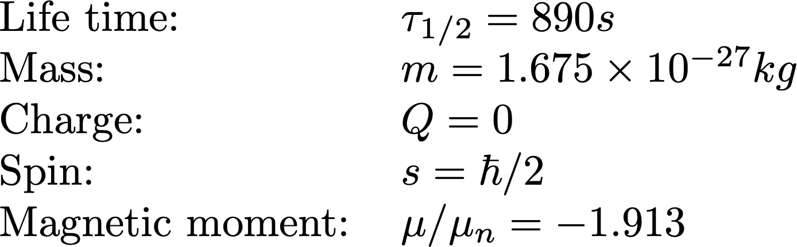
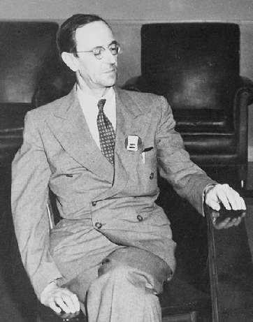
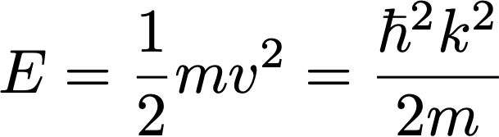
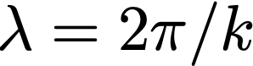
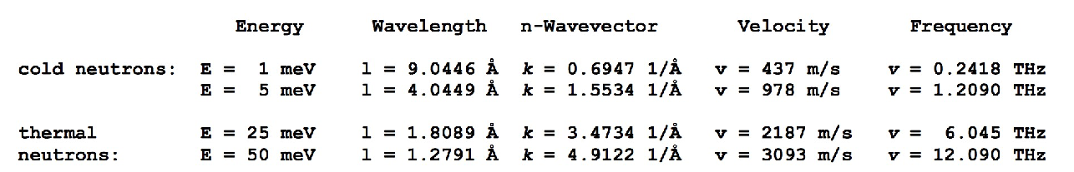
McStas: Neutrons, Monte Carlo & ray-tracing
Subatomic particle discovered by
Sir James Chadwick in 1932
,

Slide 4
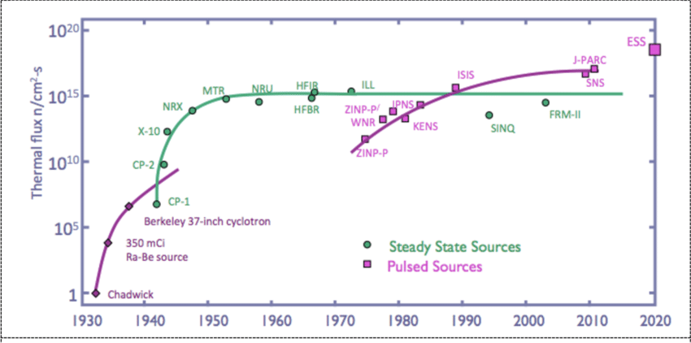
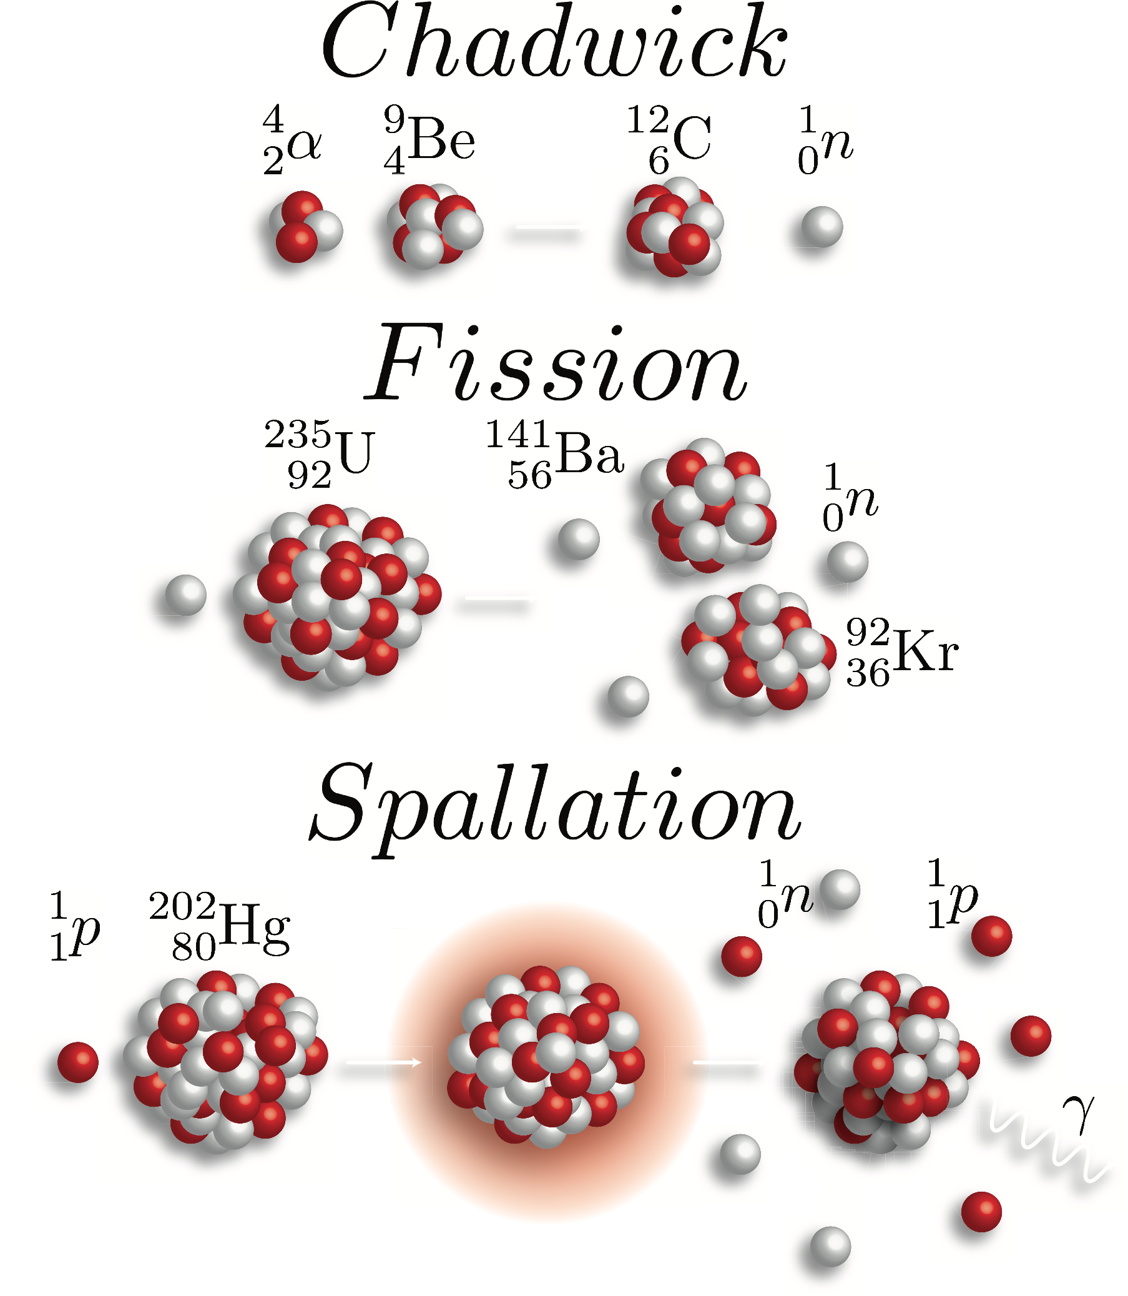
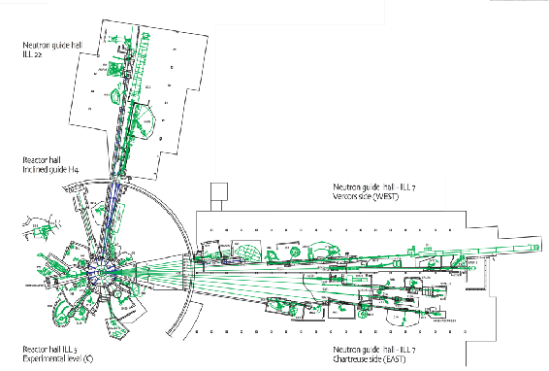
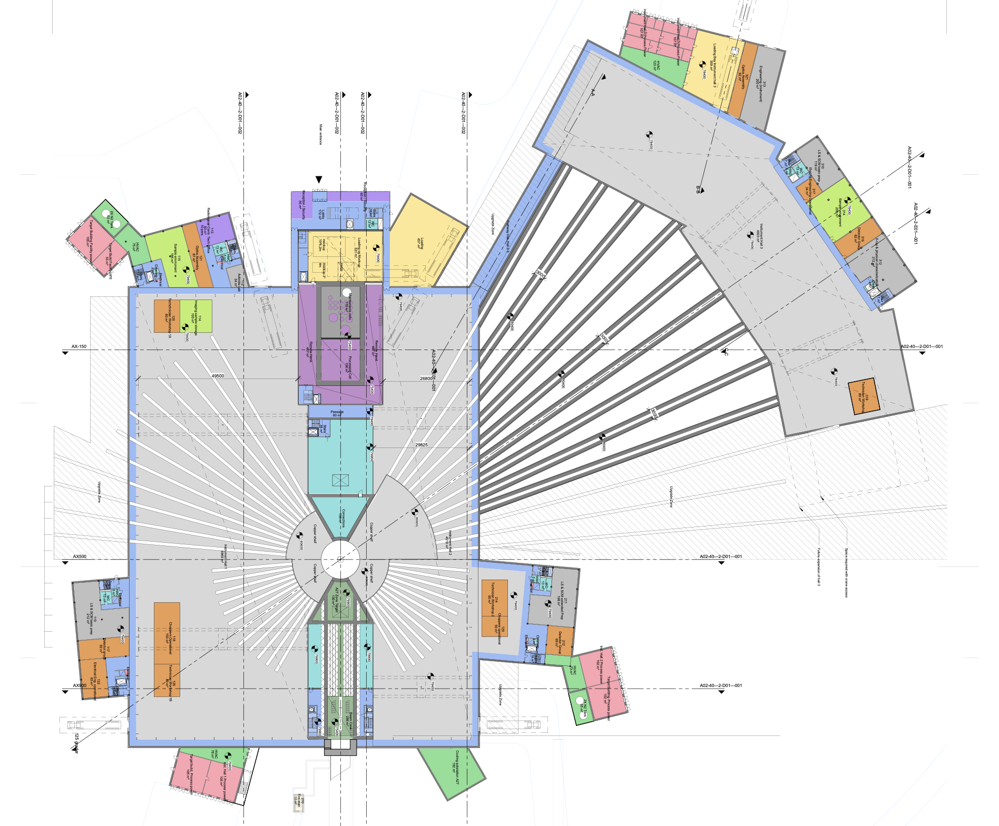


Neutron facilities

Slide 5
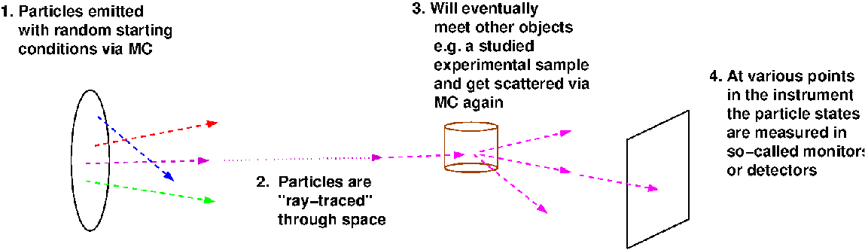
McStas is a Monte Carlo ray-tracer
Instrument
Sample
Source
Monitor
Neutrons

Slide 6
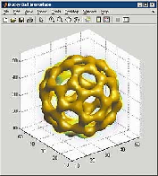
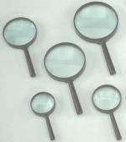
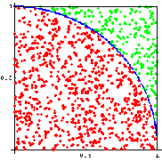
When to use Monte Carlo methods
Dimensionality of phase space must be large (d > 5)
Overall complexity is beyond reasonable analytical methods
Each event can be computed easily and independently MC is the 'lazy guy' method – think microscopic
Examples:
Estimate π from a circle/square (“Buffon needle”)
Area under/inside a curve/volume (integration)
Molecular Dynamics
spin-system phase transitions (Ising model)
nuclear reactions
ray-tracing (light, particles)
π
Number of points for which
{ x²+y²≤ 1, (x,y) ∈ [0,1] }
Ratio circle/square → π/4

Slide 7
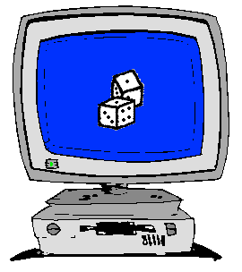
How to implement Monte Carlo methods ?
Good random generator:
from thermal electronic noise (hardware)
or quasi-random generators => quasi-Monte-Carlo
We encounter a probability 0 < p < 1.
Crude Monte-Carlo (yes/no choice):
We shoot n events ξ ∈[0,1]
We keep events that satisfy ξ < p
np events → low statistics
Importance sampling (fuzzy choice – event weighting):
Keep n events, no more random number...
But associate a weight p to each of them (we set ξ = p)
Retain statistical accuracy (1/÷n)

Slide 8
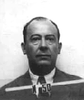
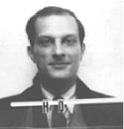
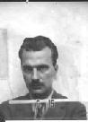
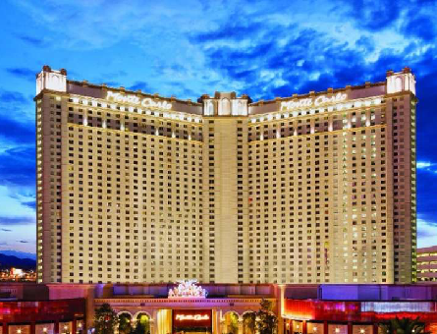
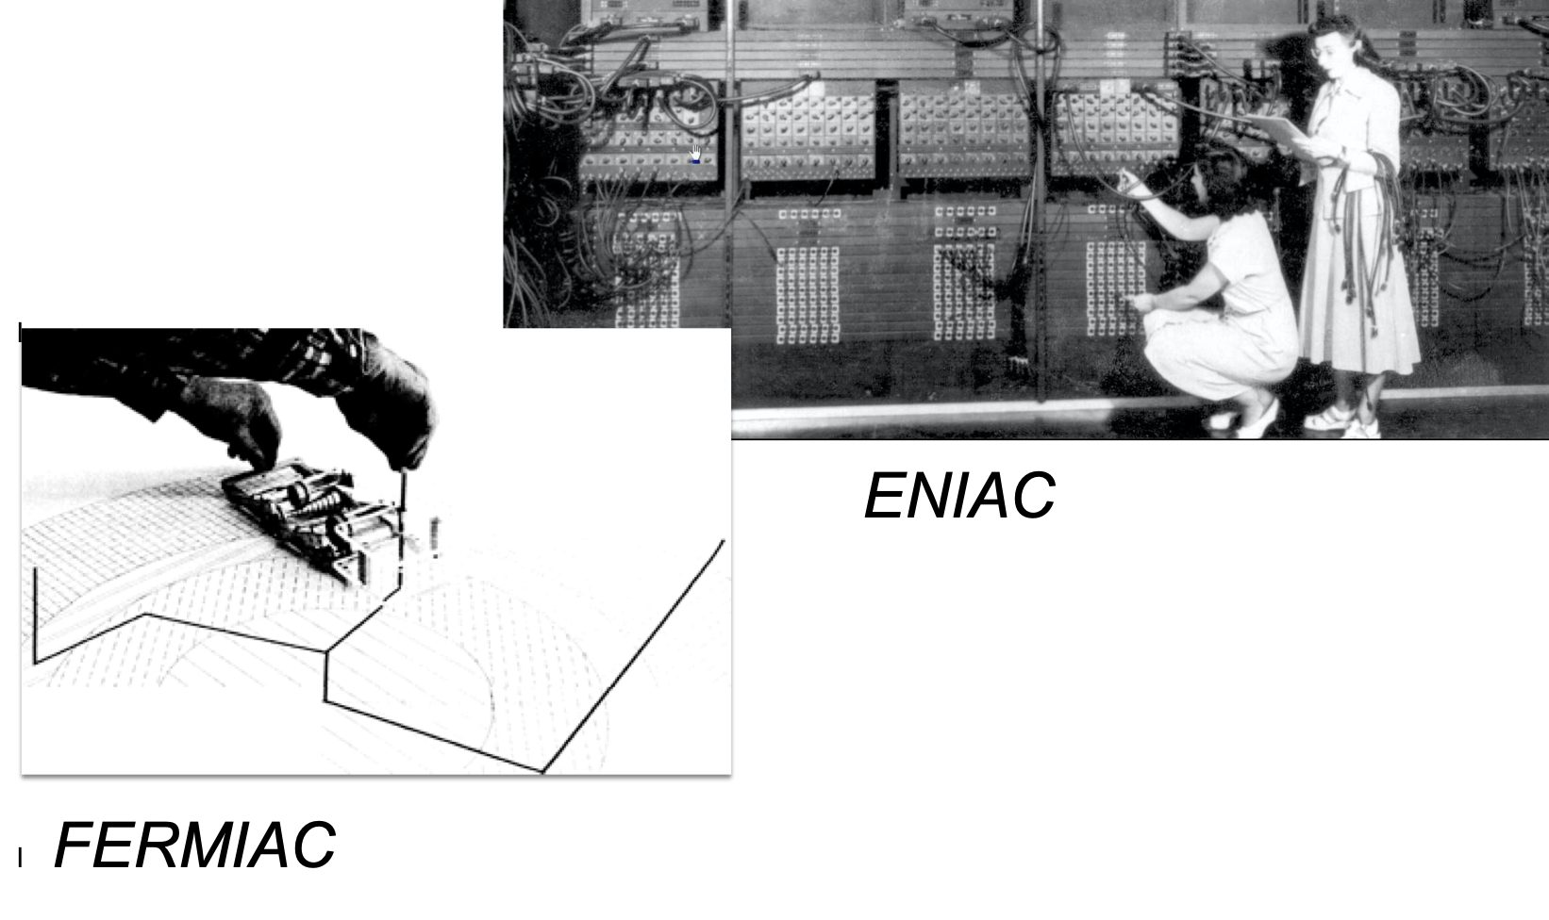
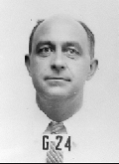
Origin of Monte Carlo methods
First application using computers:
Metropolis, Ulam and Von Neumann at Los Alamos, 1943
Neutron Scattering and Absorption in U and Pu, Origin of MCNP
Name:
Monte Carlo casino, a random generator (Ulam’s father played poker)
Bradbury Science Museum, LANL
US Army BRL UPENN

Slide 9
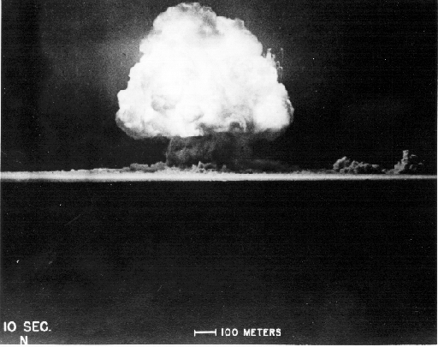
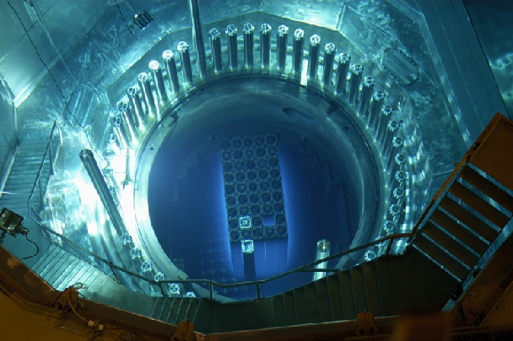
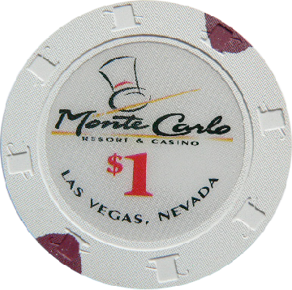
Monte Carlo techniques
Los Alamos has since then developed and perfected many different monte carlo codes leading to what is today known as the codes MCNP5 and MCNPX
State of the art is MCNP6 that features numerous (even exotic) particles
MCNP was originally Monte Carlo Neutron Photon, later N-Particle
Mainly used for high-energy particle descriptions in weapons, power reactors and routinely used for estimating dose rates and needed shielding
Does not to date handle crystalline / ordered material and coherent scattering of neutrons due to the focus on high energies

Slide 10
Examples of Monte Carlo programs
Each time physics takes place (scattering, absorption, …)
random choices are made.
Light ray-tracing: PoV-RAY and others ...
Nuclear reactor simulations (neutron transport):
MCNP, Tripoli, GEANT4, FLUKA
Neutron Ray-Tracing propagation:
McStas <www.mcstas.org>, Vitess, Restrax, NISP, IDEAS, McVine
Neutrons are described as (r, v, s, t), and are transported along
instrument models.
Propagation simply uses Newton rules, incl. gravitation.
X-ray tracing
Shadow, McXtrace, RAY, …

Slide 11
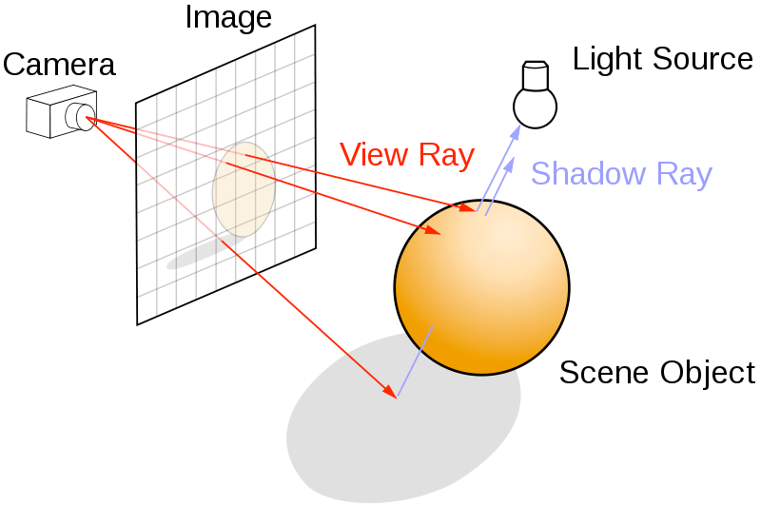
Ray-tracing methods
When neutrons move in “free space”, we use ray-tracing - but in most cases in direction source -> detector
Of course parabolas rather than straight lines are uses to implement gravity

Slide 12
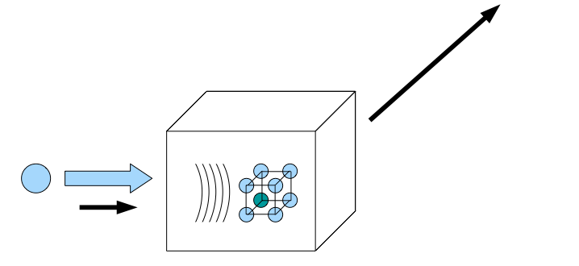
Elements of Monte-Carlo raytracing
Instrument Monte Carlo methods implement coherent scattering effects
Uses deterministic propagation where this can be done
Uses Monte Carlo sampling of “complicated” distributions and stochastic processes and multiple outcomes with known probabilities are involved
- I.e. inside scattering matter
Uses the particle-wave duality of the neutron to switch back and forward between deterministic ray tracing and Monte Carlo approach
Result: A realistic and efficient transport of neutrons in the thermal and cold range

Slide 13
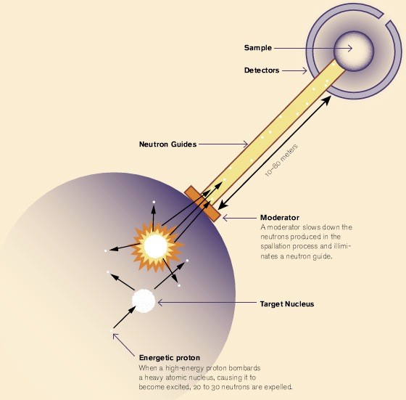
Components of neutron instruments

Slide 14
Components of neutron instruments
In McStas the moderator is the “source”

Slide 15
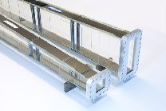
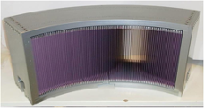
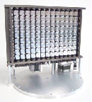
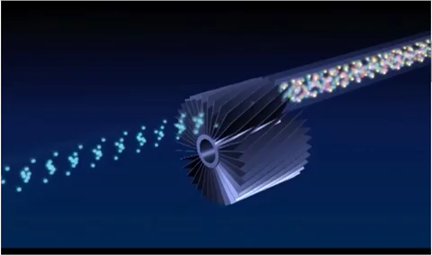
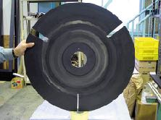
Components of neutron instruments
Neutron optics include things like:
Mirrors and guides
Collimators and slits
Diskchoppers, Fermi choppers and velocity selectors
Monochromators/Analysers
In McStas the moderator is the “source”

Slide 16
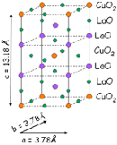
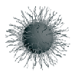
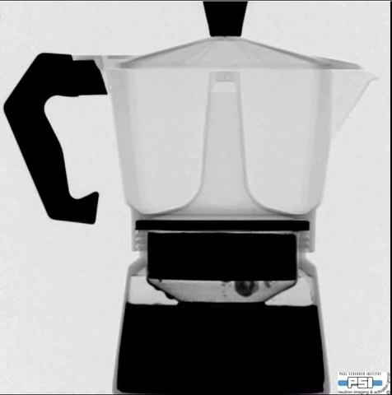
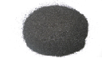
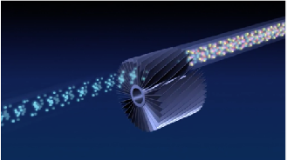
Components of neutron instruments
The sample:
Crystalline, powders, liquids, micelles, structures to image, inelastic features like phonons…
Neutron optics include things like:
Mirrors and guides
Collimators and slits
Diskchoppers, Fermi choppers and velocity selectors
Monochromators/Analysers
In McStas the moderator is the “source”

Slide 17
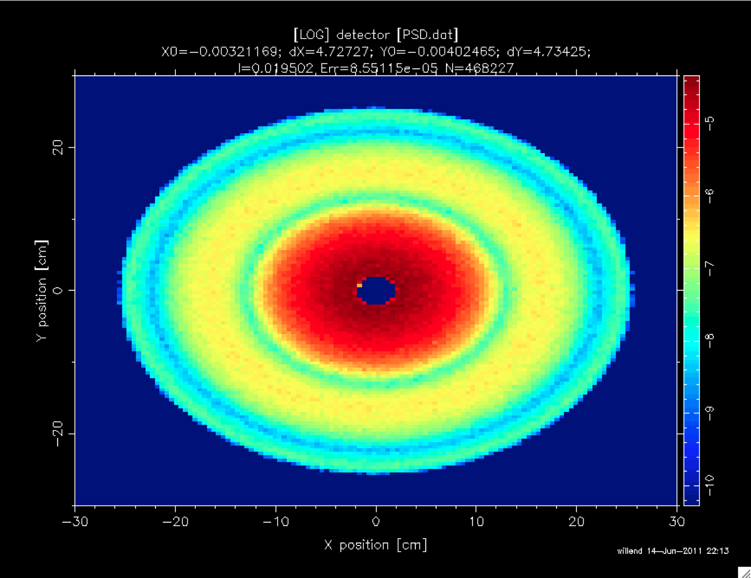
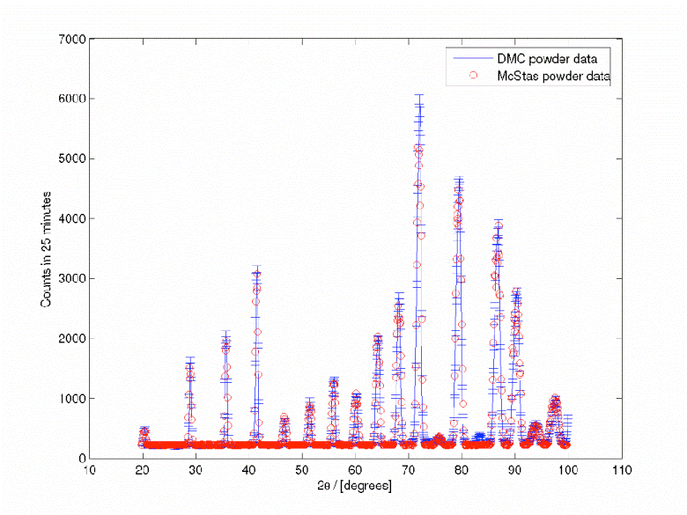
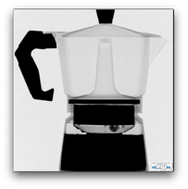
Components of neutron instruments
Detectors are “monitors” in McStas. Mostly they act as “perfect probes” and can be positioned thought your instrument gathering 1D/2D/ event lists…
The sample:
Crystalline, powders, liquids, micelles, structures to image, inelastic features like phonons…
Neutron optics include things like:
Mirrors and guides
Collimators and slits
Diskchoppers, Fermi choppers and velocity selectors
Monochromators/Analysers
In McStas the moderator is the “source”

Slide 18

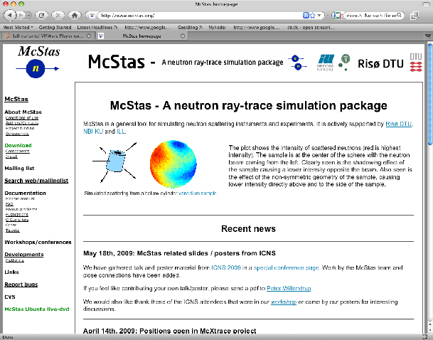
McStas Introduction
Flexible, general simulation utility for neutron scattering experiments.
Original design for Monte carlo Simulation of triple axis spectrometers
Developed at DTU Physics, ILL, PSI, Uni CPH, ESS DMSC
V. 1.0 by K Nielsen & K Lefmann (1998) RISØ
Currently 2.5+1 people full time plus students
GNU GPL license
Open Source
Project website at
http://www.mcstas.org
mcstas-users@mcstas.org mailinglist

Slide 19
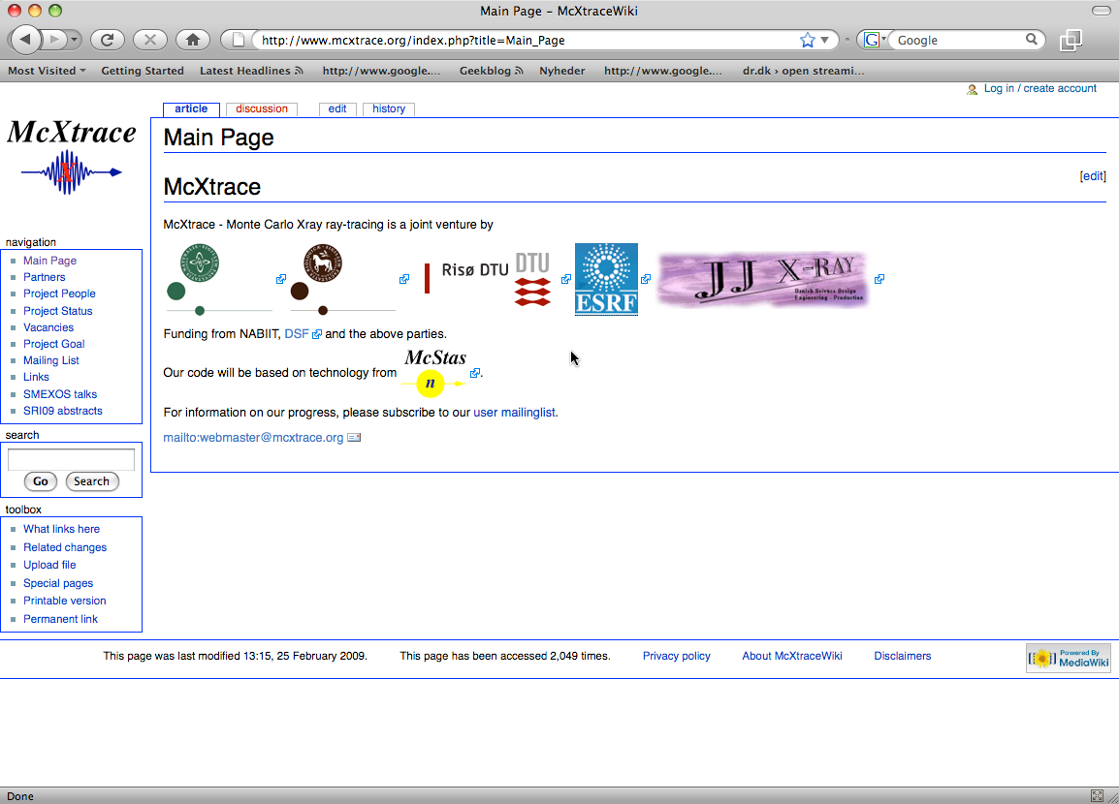
McStas Introduction
McXtrace - since jan 2009 similar for X-rays
Flexible, general simulation utility for neutron scattering experiments.
Original design for Monte carlo Simulation of triple axis spectrometers
Developed at RISØ DTU, KU and ILL, Grenoble.
V. 1.0 by K Nielsen & K Lefmann (1998)
Currently 2.5+1 people full time plus students
GNU GPL license
Open Source
Project website at
http://www.mcstas.org
neutron-mc@risoe.dk mailinglist
Synergy, knowledge transfer, shared infrastructure
4

Slide 20
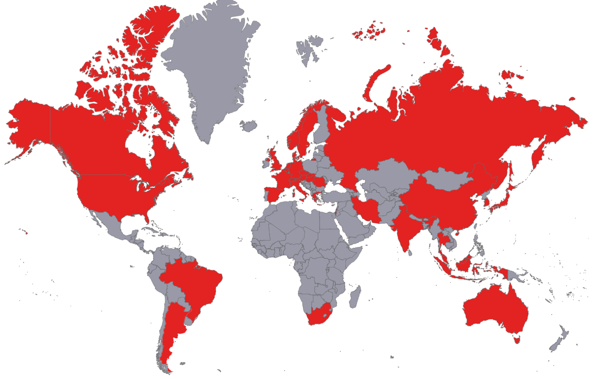

















Used in many places

Slide 21
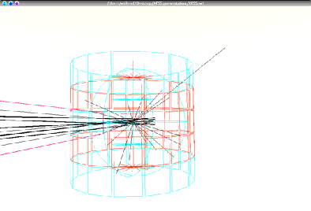
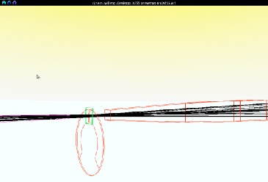
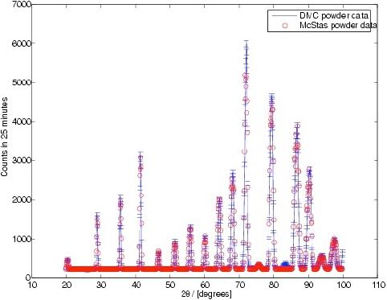
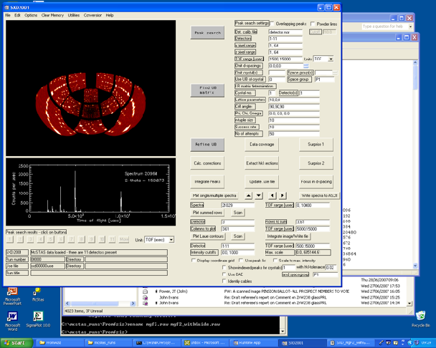
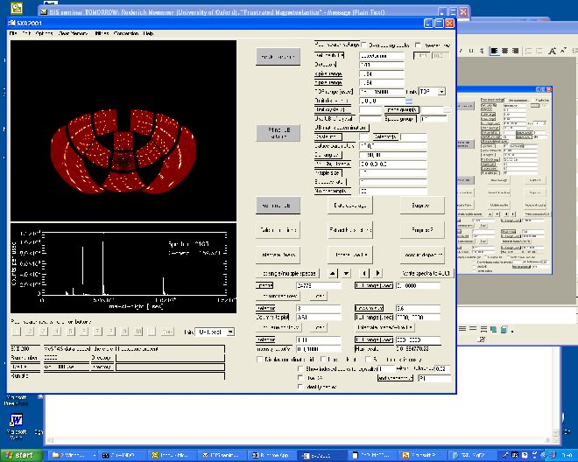
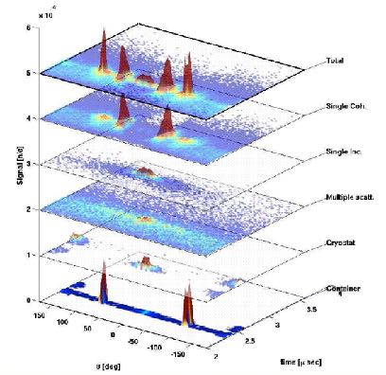
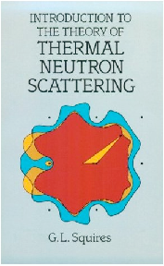


What is McStas used for?
Instrumentation
Planning
Construction
Virtual experiments
Data analysis
Teaching
(KU, DTU)

Slide 22

Reliability - cross comparisons
Much effort has gone into this
Here: simulations vs. exp. at powder diffract. DMC, PSI
The bottom line is
McStas agree very well with other packages (NISP, Vitess, IDEAS, RESTRAX, ...)
Experimental line shapes are within 5%
Absolute intensities are within 10%
Common understanding: McStas and similar codes are reliable
E. Farhi, P. Willendrup
P. Willendrup et al., Physica B, 386, (2006), 1032.

Slide 23




McStas overview
Portable code (Unix/Linux/Mac/Windoze)
Ran on everything from iPhone to 1000+ node cluster!
'Component' files (~100) inserted from library
Sources
Optics
Samples
Monitors
If needed, write your own comps
DSL + ISO-C code gen.

Slide 24

Under-the-hood / inner workings
Domain-specific-language (DSL) based on compiler technology (LeX+Yacc)
Simple Instrument language ISO C
Component codes realizing beamline parts (including user contribs)
Library of common functions for e.g.
I/O
Random numbers
Physical constants
Propagation
Precession in fields
...
Code generation

Slide 25

Implementation

Slide 26


Instrument file

Slide 27



Component file

Slide 28



Generated c-code

Slide 29


Writing new comps or understanding existing is not that complex...
Check our long list of components and look inside... Most of them are quite simple and short... Statistics:
Number of lines of code per component - 199 comps in total
(update: 175)

Slide 30
Writing new comps or understanding existing is not that complex...
Check our long list of components and look inside... Most of them are quite simple and short... Statistics:
Number of lines of code per component - 199 comps in total
(update: 175)
Well-developed community support
30-40% of existing and new additions are from users
No direct refereeing of the code, but these requirements:
At least one test-instrument
Meaningful documentation headers (in-code docs)
Contributions go in dedicated contrib/ section of library

Slide 31










Example suite: ~140 instruments

Slide 32


